Slide 1

Software - Khoa
AI Navigation, Waste Detection,
Real-Time Inference Pipeline and Recycle Classifier

Slide 2
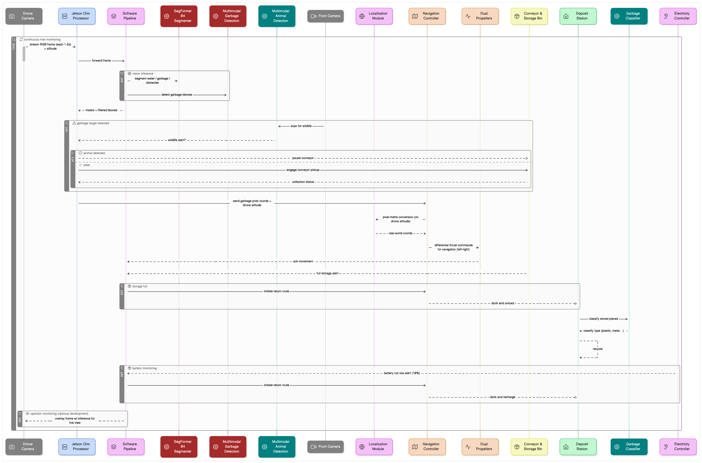
System
Design
Website accessible via:
https://binkhoale1812-sall-egarbagedetection.hf.space/ui

Slide 3
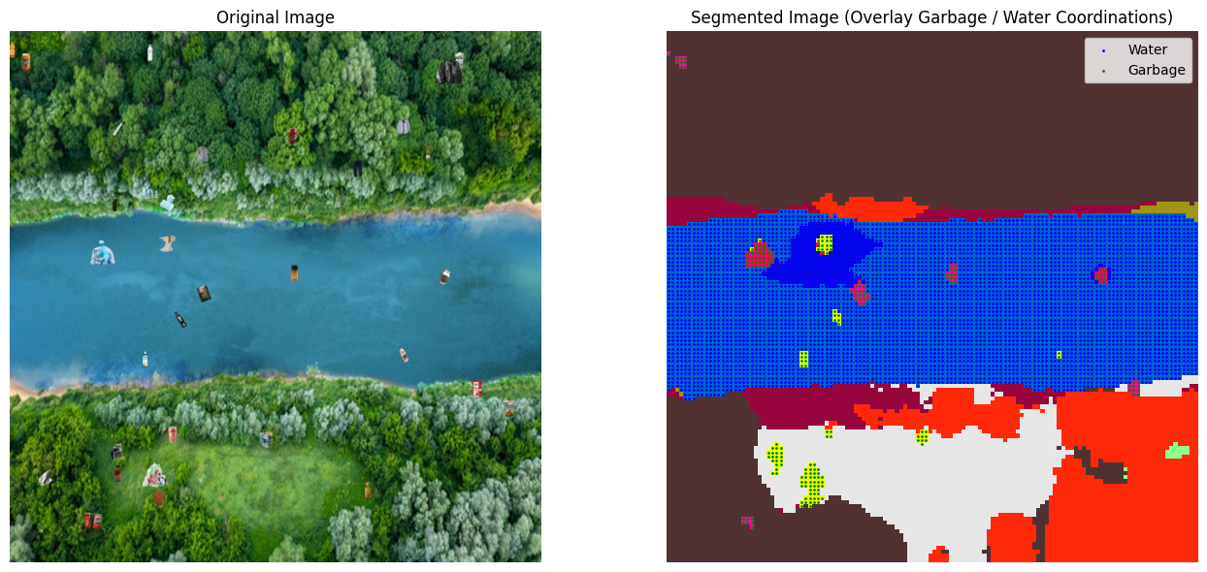
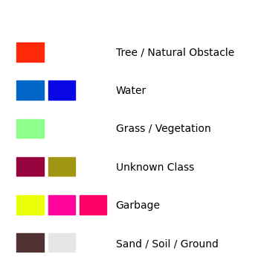
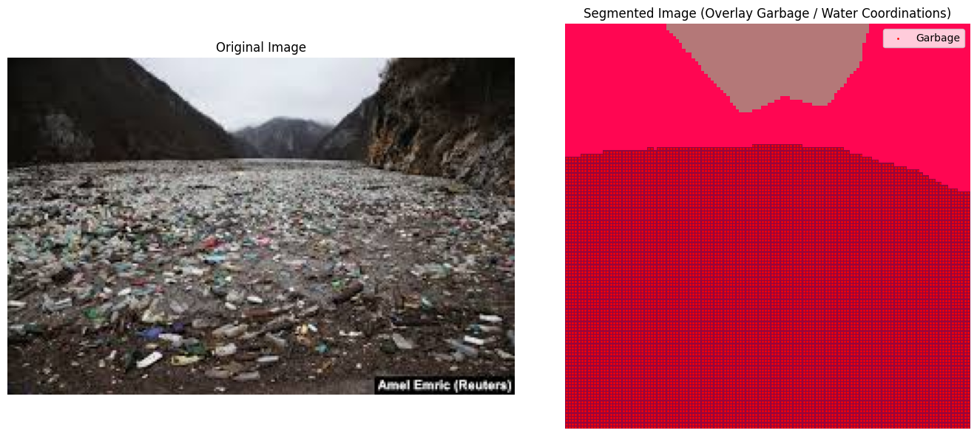
Segmentation
Model: nvidia/segformer-b4-finetuned-ade-512-512
Detects: Water, Garbage, Trees, Sand, Structures
🔍 SegFormer-B4 achieves 84.4% mIoU on ADE20K with strong performance under terrain variation (NVIDIA 2021).

Slide 4
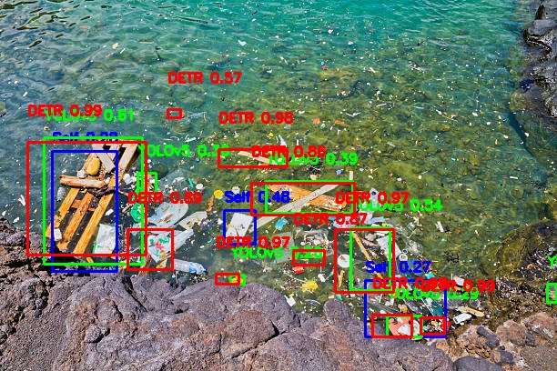
Object Detection
YOLOv11l (self-trained)
YOLOv5 (CNN)
DETR (Transformer-based)
YOLO+DETR multimodal system is well-designed architecture (Fahim Rustamy, PhD, 2023)

Slide 5
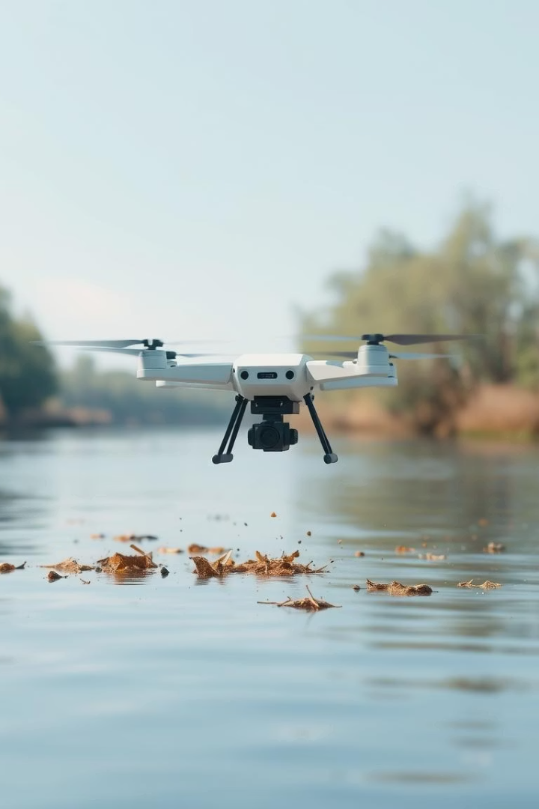
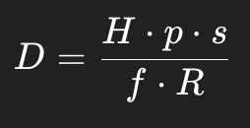
Navigation
Debris Removal
Path Optimization
Debris only flagged as collectable in movable zones
A* + KNN reduces total path by 22% over baseline BFS (Cui et al., 2017)
Deployment Stage
Apply mathematical program
localizing pixel to meter-based
coordination with drone’s altitude.
Experiment Result
96% average successful collection rate across 10 simulation tests
A-star algorithm
f(n) = g(n) + h(n)

Slide 6
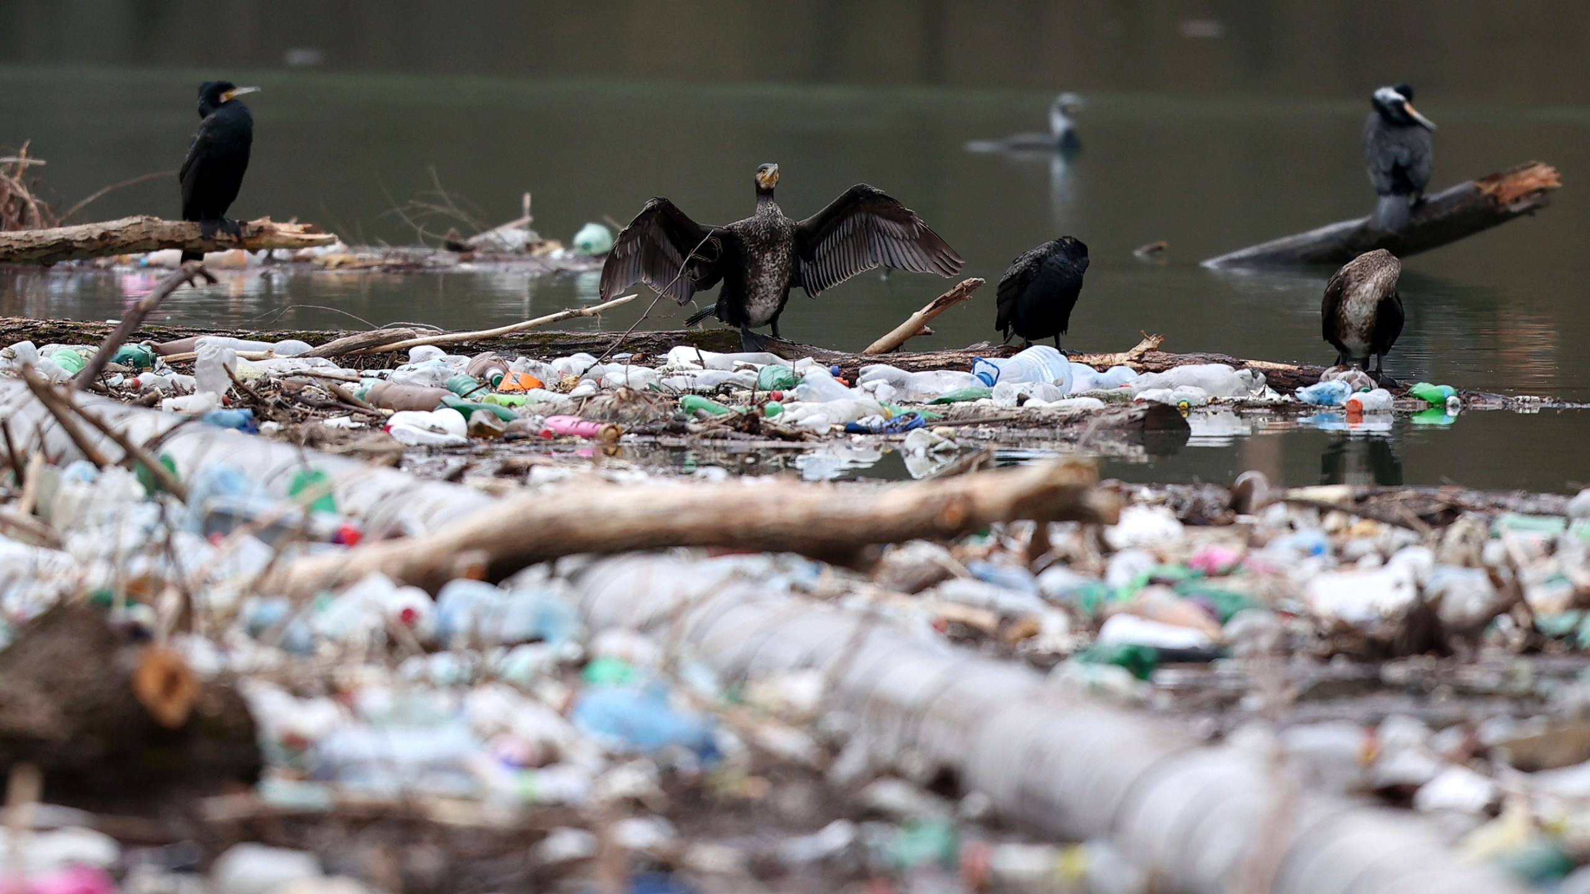
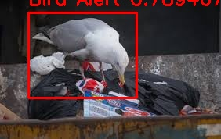
Wildlife Detection
Model Stack:
YOLOv8n → mammals and birds (80+ COCO classes)
Fish model → small fish in garbage areas
Bird model → birds perched on floating debris
Control Behaviour:
Frames with any valid detection halt conveyor pickup
Resume only when clear — updated each frame
No extra sensors required — purely vision-based
🔍 YOLOv8n chosen for its low-latency inference (<20 ms/frame) and edge compatibility.

Slide 7

Runtime Performance
Hardware:
Jetson Orin 64 GB (35W TDP)
Drone video streaming service
Metrics:
Segmentation: ~40 ms
Detection: ~35 ms
Total processing: < 100 ms per frame
10 FPS video streaming (H.264)

Slide 8
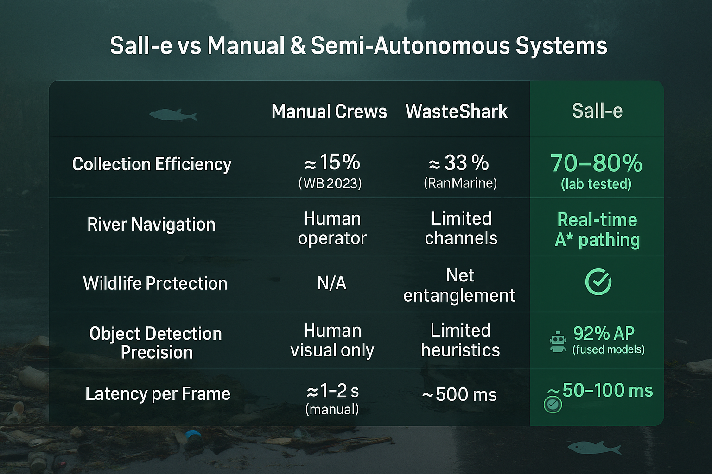

Slide 9
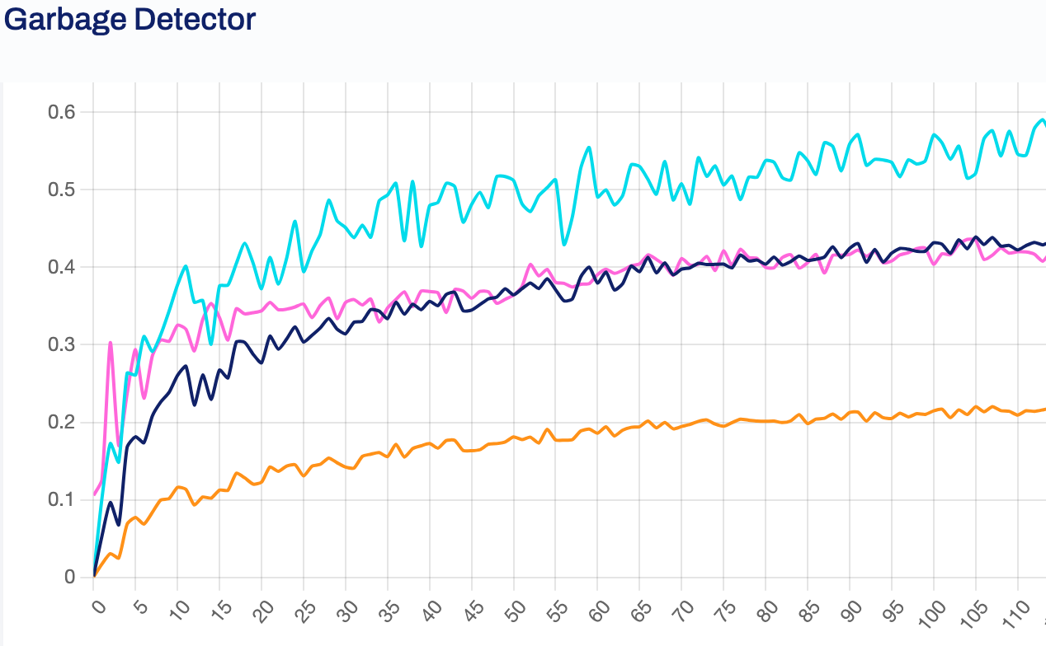
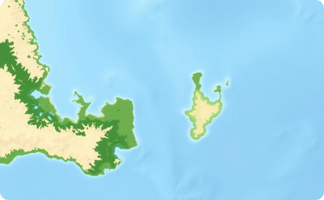
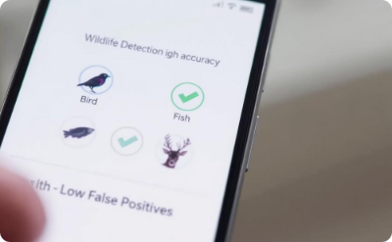
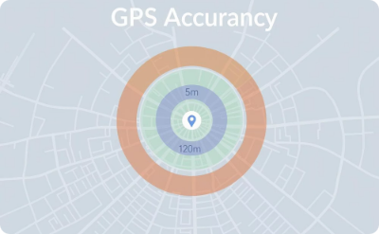
Expected Results
Vision fusion F1 score improved from 0.84 to 0.92
SegFormer mask mIoU steady at 50% (ADE20K)
Wildlife pause reduces false scoops from 4% to <1%
GPS scaling cuts position error from ~2 m to ±0.8 m

